Slide 1




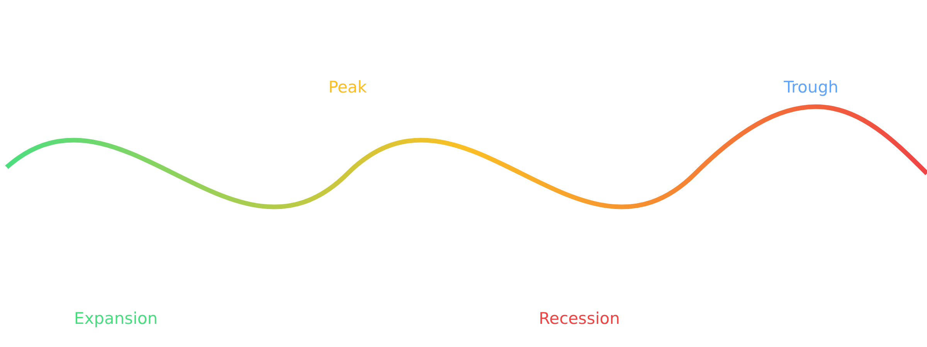
Recessions in Macroeconomics
Understanding the Economic Rollercoaster
An Undergraduate Course on Macroeconomic Concepts
Report Date: 2025-12-15

Slide 2











Why Should You Care About Recessions?
Understanding recessions isn't just for economists or policymakers—it directly impacts your future.
Job Prospects
Economic Decisions
Career Planning
Recessions often lead to fewer job opportunities and increased competition for positions.
Understanding economic cycles helps you make better financial decisions.
Recessions can influence which fields have more stable employment.
Family Finances
Economic instability can affect your family's financial security and planning.
Daily Costs
Financial Literacy
Social Impact
Recessions can affect the cost of everyday items, from coffee to textbooks.
Economic downturns test our financial resilience and planning.
Recessions affect communities and social structures more broadly.
" By grasping what a recession is and how it affects us, you'll be better equipped to navigate the economic landscape and make informed decisions. "
2/14

Slide 3



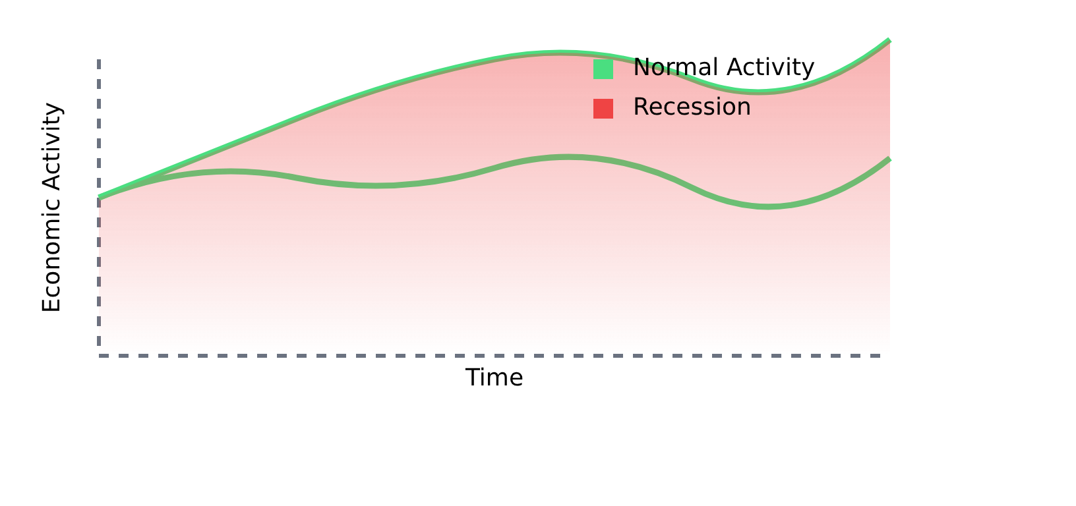





What is a Recession?
A recession is a significant and widespread slowdown in economic activity.
Recession vs. Normal Economic Fluctuations
Significant Decline
A noticeable drop in overall economic activity.
Widespread Impact
Affects many sectors of the economy, not just a few.
Duration
Lasts more than a few months, not just a temporary dip.
Common Rule of Thumb:
2 consecutive quarters of declining GDP
Note: The official definition considers multiple factors including breadth, depth, and duration.
" A recession is when the economy takes a noticeable and broad step backward. "
3/14

Slide 4

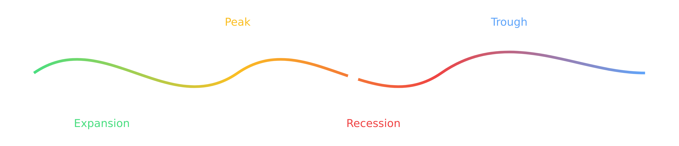















The Business Cycle
Economies naturally move through phases, much like seasons. This cyclical pattern includes periods of growth and slowdown.
Expansion
Peak
Contraction
Trough
Economic growth
Highest growth point
Economic slowdown
Lowest point
Rising employment
Before slowdown
Rising unemployment
Beginning recovery
Recessions are a normal, albeit challenging, part of this natural economic cycle.
4/14

Slide 5


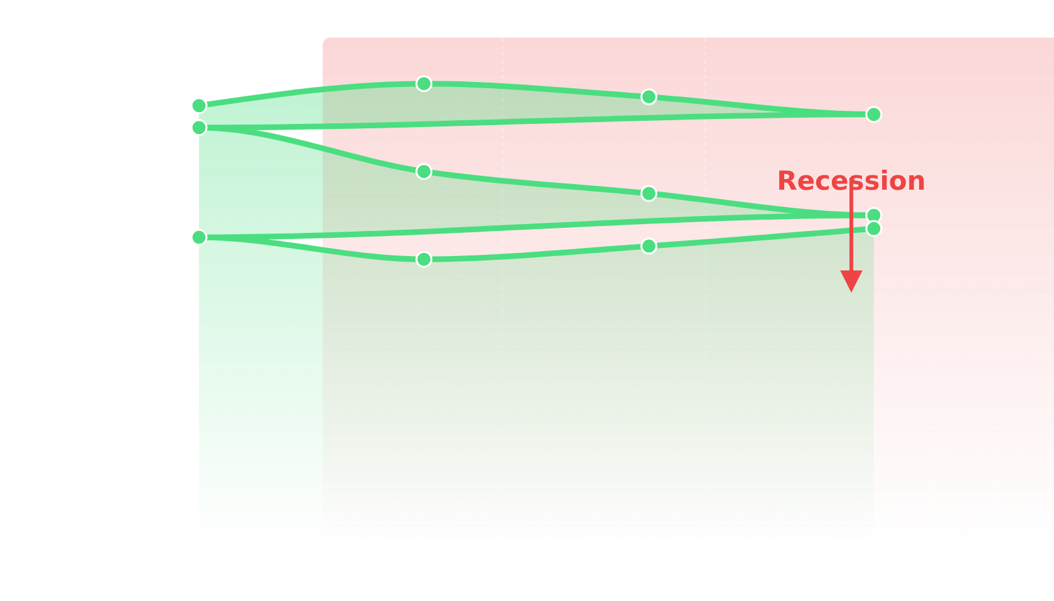







Key Indicator: GDP Decline
What is GDP?
GDP Trend During Recession
GDP measures the total value of all goods and services produced within a country's borders over a specific period.
Think of GDP as the economy's speedometer. When it's consistently going down, it signals trouble.
Why It Matters
During a recession, businesses produce less
Consumers buy less goods and services
Overall economic activity shrinks
Common rule of thumb: 2 consecutive quarters of decline
GDP
Recession Period
The official definition of a recession looks for a significant and widespread downturn in GDP, not just two declining quarters.
5/14

Slide 6



















Key Indicator: Rising Unemployment
What is Unemployment Rate?
How Recessions Affect Unemployment
The unemployment rate measures the percentage of the labor force that is actively looking for work but cannot find a job.
Economic Downturn
Business Struggles
Why It Matters
During a recession, businesses face reduced demand and lower profits, leading to:
Slowed hiring
Frozen positions
Job Losses
Rising Unemployment
Layoffs of existing workers
During the COVID-19 recession, U.S. unemployment spiked from 3.5% in February 2020 to 14.7% in April 2020
6/14

Slide 7













Key Indicator: Falling Consumer Spending
Consumer Spending Overview
How Consumer Spending Creates a Negative Feedback Loop
Consumer spending is the total money spent by households on goods and services. It's a huge driver of economic activity.
Consumer Confidence
Increased Spending
During Economic Uncertainty
More money circulating in economy
People feel secure about jobs and future
People become more cautious
Households save more
Purchases are limited to essential items
Big-ticket items like cars or appliances are delayed
Business Revenue
Higher sales and profits
Negative Feedback Loop
Employment
When consumers spend less, businesses suffer, leading to layoffs, which further reduces economic activity.
More jobs and stable income
WORSE
RECESSION
" When millions of people pull back their spending, businesses suffer, and the economic slowdown intensifies. "
7/14

Slide 8

















Why Do Recessions Happen?
The Intuitive Cause
Types of Shocks
Recessions often begin with a loss of confidence, leading to reduced spending.
Financial Crises
Supply Shocks
Problems in banking system or asset markets (e.g., housing bubble)
Disruptions to supply of essential goods or resources (e.g., oil price spikes)
People & Businesses
Become uncertain about the future
Reduced Spending
Delay big purchases, cut back on non-essentials
Demand Shocks
External Events
Sudden drop in consumer and business spending
Geopolitical events, natural disasters, or public health crises
Economic Slowdown
Lower sales lead to fewer jobs and less income
Recessions don't just appear out of nowhere—they are often triggered by significant events or "shocks" to the economic system.
8/14

Slide 9













The Vicious Cycle
Once a shock hits and confidence wavers, a self-reinforcing negative feedback loop can take hold, making the downturn worse.
Consumer Spending Decreases
Business Revenues Fall
Fewer sales lead to lower profits
People worry about jobs or income, spend less, save more
Downward Spiral
Unemployment Rises
Companies Cut Back
More people lose jobs, decreasing income and security
Reduce production, delay investments, lay off workers
" This cycle illustrates how an initial downturn can gain momentum, pulling the economy deeper into a recession. "
9/14

Slide 10















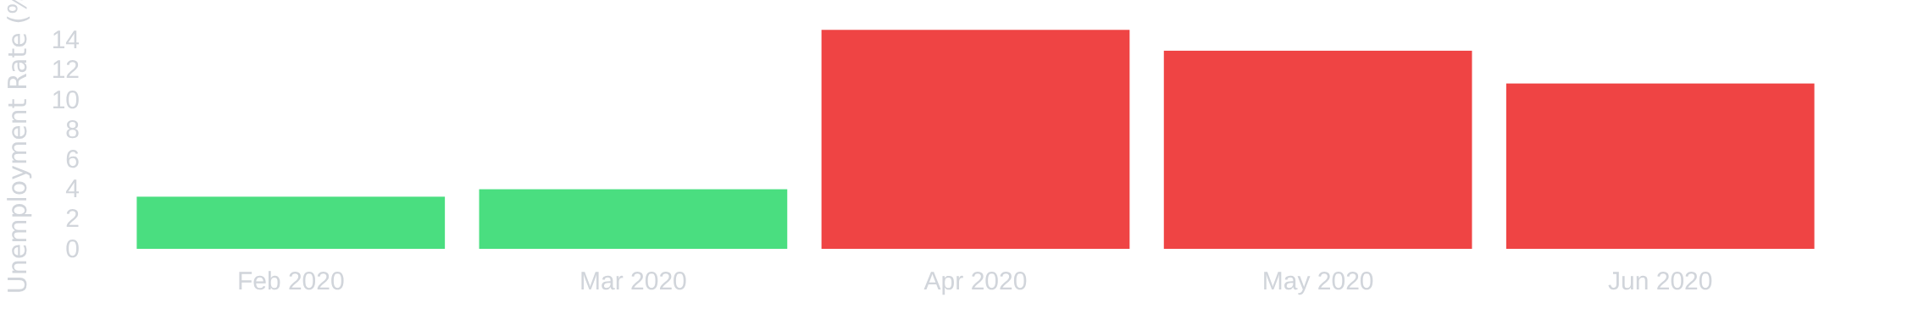

Real Example: COVID-19 Recession
The COVID-19 recession demonstrated how external shocks can trigger severe economic downturns.
Timeline & Key Facts
Causes
Impacts
Unique
February 2020
Virus emerges
Public Health Crisis
31.4% GDP Decline
Shortest Recession
Government Lockdowns
Unemployment: 3.5% → 14.7%
Rapid Rebound
March-April 2020
Sudden Economic Halt
Public Health Trigger
Lockdowns begin
Shift to Online Retail
June 2020
Q2 GDP: -31.4%
Unemployment Rate Surge
September 2020
Q3 GDP: +33.4%
10/14

Slide 11

















Policy Responses
When recessions hit, governments and central banks deploy policy tools to soften the blow and speed recovery.
Fiscal Policy
Monetary Policy
Government actions to adjust spending and taxation to influence economic activity.
Central bank actions to manage money supply and credit conditions.
Key Tools:
Key Tools:
Increased Government Spending
Interest Rate Adjustments
Direct injections into the economy
Lower rates to encourage borrowing
Tax Cuts
Quantitative Easing
Leave more money in consumers' pockets
Creating new money to purchase assets
Transfer Payments
Bank Reserve Requirements
Unemployment benefits, stimulus checks
Adjusting how much banks must hold
Example: During COVID-19, U.S. fiscal stimulus approached World War II levels as a share of GDP.
Example: During COVID-19, the Fed lowered rates and extended lending terms to encourage banks to lend.
Both policies aim to restore economic growth, but work through different mechanisms.
11/14

Slide 12









Why Recessions Matter to Your Life
Recessions aren't just abstract economic concepts—they directly impact your financial well-being and life decisions.
Job Security
Wage Growth
Finding employment becomes more challenging
Salary increases often slow down or halt during downturns
Existing jobs may be at risk during company downsizing
Competitive job market can lead to underemployment
Reduced bargaining power for workers
Focus on retaining current position rather than advancement
Investment Values
Borrowing Costs
Savings and investments decrease in value during market downturns
Access to credit tightens during economic uncertainty
Interest rates on loans may increase during downturns
Retirement funds and 401(k)s can see significant losses
Difficulty securing loans for major purchases or investments
May need to adjust financial goals and timelines
12/14

Slide 13













Key Takeaways
Broad Economic Slowdown
Driven by Spending
A recession is a significant, widespread decline in economic activity, not just a minor dip.
Recessions are fundamentally caused by a drop in overall spending by consumers and businesses.
Part of the Cycle
Personal Impact
Recessions are a recurring, though often painful, part of the natural business cycle.
Recessions affect jobs, wages, investment values, and borrowing costs in our daily lives.
Remember: Understanding recessions helps you navigate economic challenges and make informed decisions.
13/14

Slide 14







Discussion Question
Based on what we've discussed today, what do you think is the most likely trigger for the next recession, and why?
Financial Crises
Supply Shocks
Problems in banking systems or asset markets can restrict credit availability and stifle economic activity.
Sudden disruptions to essential goods or resources can drive up production costs and reduce economic output.
Demand Shocks
External Events
Sudden drops in consumer and business spending can lead to economic slowdowns and job losses.
Geopolitical events, natural disasters, or public health crises can severely disrupt economic activity.
Consider current economic conditions and trends. Which trigger do you think is most likely, and why?
This discussion will help us understand how different factors can contribute to economic downturns.
14/14

